Slide 1
Manage storage easily with Linux System Roles
Vojtech Trefny
vtrefny@redhat.com

Slide 2
Linux System Roles
A set of Ansible roles used to manage and configure common GNU/Linux components.
Multiple subsystems are supported – selinux, network, firewall, postfix…
Available in rhel-system-roles on RHEL and linux-system-roles on Fedora or in Ansible Galaxy¹.
https://linux-system-roles.github.io/
¹ https://galaxy.ansible.com/linux-system-roles

Slide 3
Storage Role
System role for storage configuration
Supported technologies
LVM, including LVM RAID, thin provisioning, cache and deduplication and compression with VDO
Software RAID with MD
LUKS encryption
Partition management
Filesystem management including resizing and fstab management

Slide 4
storage_pools:
- name: fedora
disks:
- vda
volumes:
- name: root
fs_type: ext4
size: 53.1 GiB
mount_point: /
- name: home
fs_type: ext4
Size: 25.9 GiB
mount_point: /home
Default Fedora installation with LVM
LVM volume group called “fedora” on top of one disk with two logical volumes “root” mounted on / and “home” mounted on /home

Slide 5
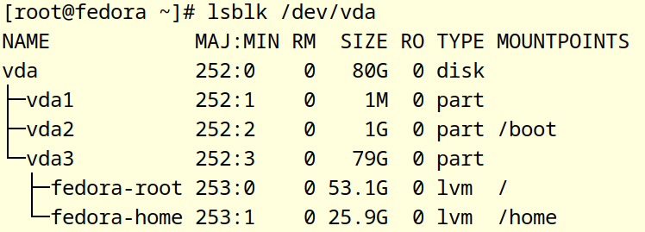
storage_pools:
- name: fedora
disks:
- vda
volumes:
- name: root
fs_type: ext4
size: 53.1 GiB
mount_point: /
- name: home
fs_type: ext4
Size: 25.9 GiB
mount_point: /home

Slide 6
storage_pools:
- name: fedora
disks:
- vda
- vdb
volumes:
- name: root
fs_type: ext4
mount_point: /
- name: home
size: 100 GiB
fs_type: ext4
mount_point: /home
More realistic scenario
We bought a new drive and want to add it to our existing volume group and resize our /home

Slide 7
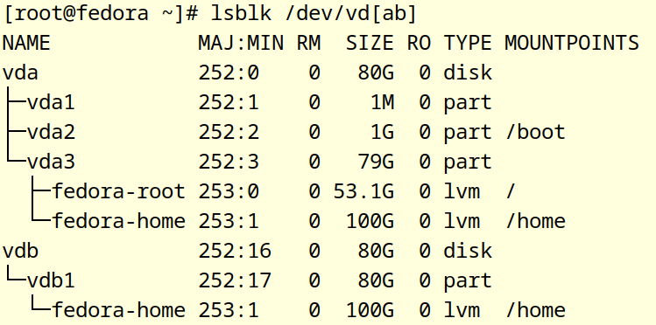
storage_pools:
- name: fedora
disks:
- vda
- vdb
volumes:
- name: root
fs_type: ext4
mount_point: /
- name: home
size: 100 GiB
fs_type: ext4
mount_point: /home
More realistic scenario
We bought a new drive and want to add it to our existing volume group and resize our /home

Slide 8
storage_pools:
- name: fedora
disks:
- vda
- vdb
- nvme0n1
volumes:
- name: root
fs_type: ext4
mount_point: /
cached: true
cache_size: 5 GiB
cache_devices: nvme0n1
More realistic scenario 2
We bought another new drive, this time it’s a fancy fast NVMe and we want to use it to speed up our root filesystem with LVM cache.

Slide 9
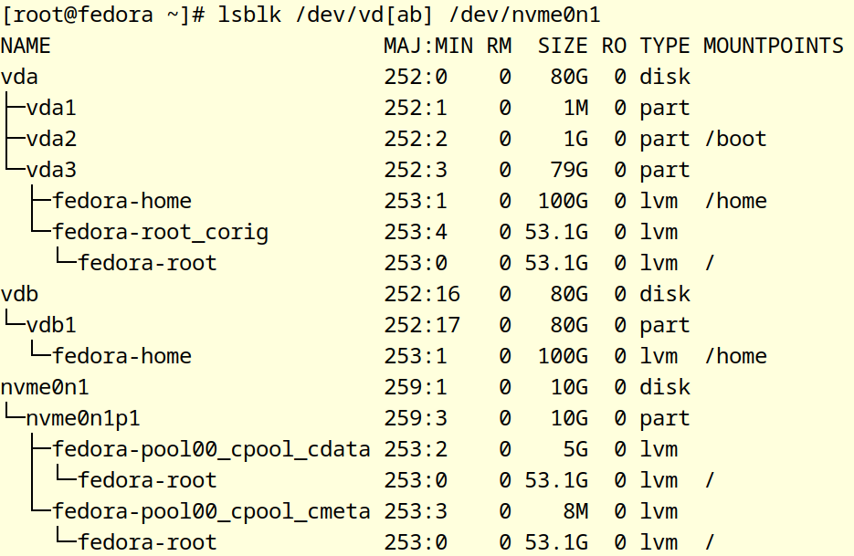
storage_pools:
- name: fedora
disks:
- vda
- vdb
- nvme0n1
volumes:
- name: root
fs_type: ext4
mount_point: /
cached: true
cache_size: 5 GiB
cache_devices: nvme0n1
A different scenario
We bought another new drive, this time it’s a fancy fast NVMe and we want to use it to speed up our root filesystem with LVM cache.

Slide 10
vars:
storage_safe_mode: false
...
storage_pools:
- name: fedora
disks:
- vda
- vdb
volumes:
- name: root
fs_type: ext4
mount_point: /
cached: false
More realistic scenario 3
We no longer want to use the NVMe drive for caching. Lets remove it.

Slide 11
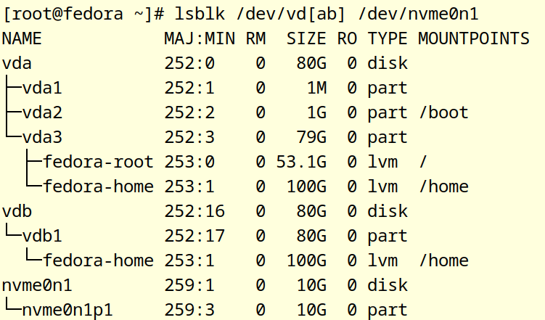
vars:
storage_safe_mode: false
...
storage_pools:
- name: fedora
disks:
- vda
- vdb
volumes:
- name: root
fs_type: ext4
mount_point: /
cached: false
More realistic scenario
I no longer want to use the NVMe drive for caching. Lets remove it.

Slide 12
What’s next?
Coming soon (RHEL 8.9/9.3)
  Filesystem online resize
  Mount point owner and permission
In the future
  More “configuration” options for existing storage.
  More storage technologies: Stratis, btrfs…
  Snapshots

Slide 13
Thank you for your attention
WWW
  https://linux-system-roles.github.io/
  https://galaxy.ansible.com/linux-system-roles
GitHub
  System roles: https://github.com/linux-system-roles
  Storage role: https://github.com/linux-system-roles/storage
Contact:
  systemroles@lists.fedorahosted.org
  vtrefny@redhat.com

